Slide 1
NEO4J CYPHER TUTORIAL WITH PYTHON
Delete Nodes From Neo4j Graph By Reading Json Input Using Cypher ,Apoc & Python
Tutorial 92

Slide 2
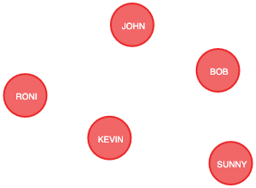
Present State

Slide 3
Sample csv
{type: "Student",name: "RONI"}
{type: "Student",name: "SUNNY"}

Slide 4
Use case
Delete nodes from neo4j graph from json input using cypher ,apoc & python

Slide 5
Pre-requisites
apoc.import.file.enabled=true
apoc.import.file.use_neo4j_config=false

Slide 6
Delete node from graph using json input
call apoc.load.json("file:///users/roni/data/json_data/sample.json")
yield value
unwind value.type as type
unwind value.name as name
match(a{NAME:name})
unwind labels(a) as label
with a,type,label
where label=type
delete(a)
Code written in neo4j browser

Slide 7
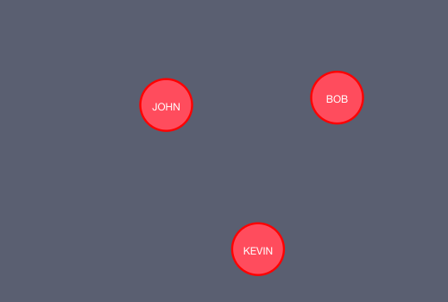
output
From neo4j browser

Slide 8
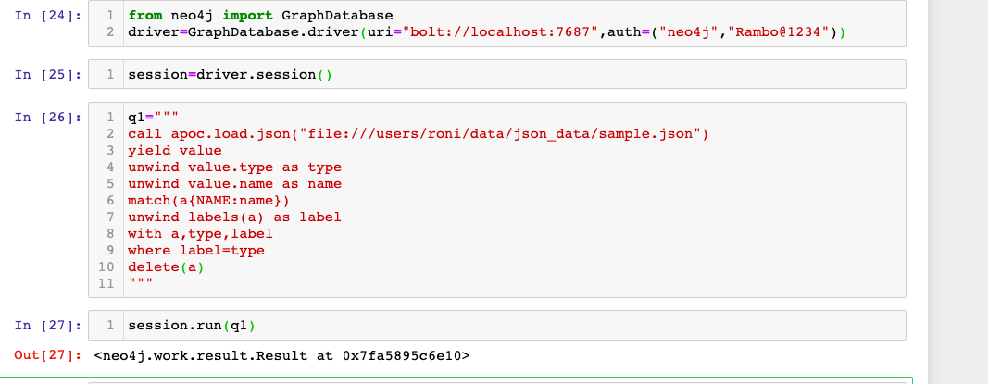
Delete node from graph using csv input
Code written in python ide

Slide 9
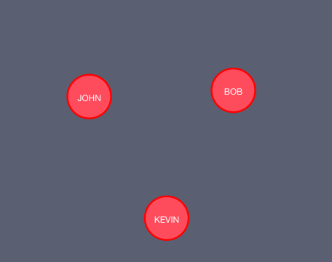
output
From python ide

